Slide 1
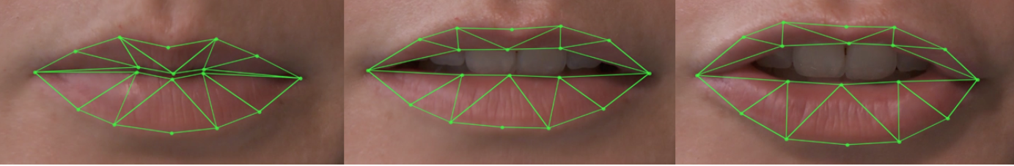
Audio-visual speech recognition

Slide 2
Group Member
Ahmad Raza
FA18-BCS-005
Kainat Iqbal
FA18-BCS-021
Usama
FA18-BCS-048

Slide 3
Supervised by
DR M. Azhar

Slide 4
Table Of Content
Introduction
Problem Statement
Solution
Scope
Hper Parameters
Algorithm
Process Flow
Functional Requirements
Non-Functional Requirements
Tools and Technologies
Architecture
Future Work
Conclusion

Slide 5
Introduction
Lip reading is a technique which is used to understand words or speech by visual interpretation of face, mouth, and lip movement without the involvement of audio.
It is helpful for the people who are unable to hear we have many problems in sending and receiving messages.
Lipreading also known as visual language recognition, is a way of visually interpreting the lip
Movement of lips by looking at their faces to recognize what is being said.

Slide 6
Problem Statement
First problem is to communicate in noisy areas. Like in factory areas the workers cannot convey their visual messages .
The important issue is that a person lost voice accidently.
During the video conferencing call, or any online meeting due to weak internet signals voice often drops. The result is judged based on accuracy.

Slide 7
Solution
The system provides the facility of better communication for faulty persons.
Communication is better by reading the text generated by the recognition of lip movement.
By lip movement an individual interprets what the organizer is trying to said.
It scan the lips from the camera sensor and generate visual features into the text.
This will improve the transmission of the voice and important visual messages.

Slide 8
Hyper Parameters
# 1st parameter - run_name
# 2nd parameter - start_epoch
# 3rd parameter - stop_epoch
# 4th parameter - img_c (num of channel)
# 5th parameter - img_w
# 6th parameter - img_h
# 7th parameter - frames_n
# 8th parameter - minibatch_size
run_name = datetime.datetime.now().strftime('%Y:%m:%d:%H:%M:%S')
train(run_name, 0, 5000, 3, 100, 50, 75, 50)

Slide 9
Algorithm
LipNet :
It is the first End-to-End sentence level lip reading model.
It simultaneously learns visual features.
It maps variable-length sequence of video frames to text.
It works on GRID corpous

Slide 10
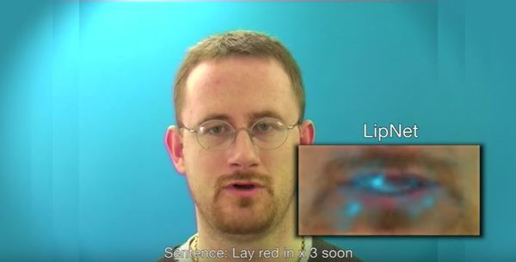
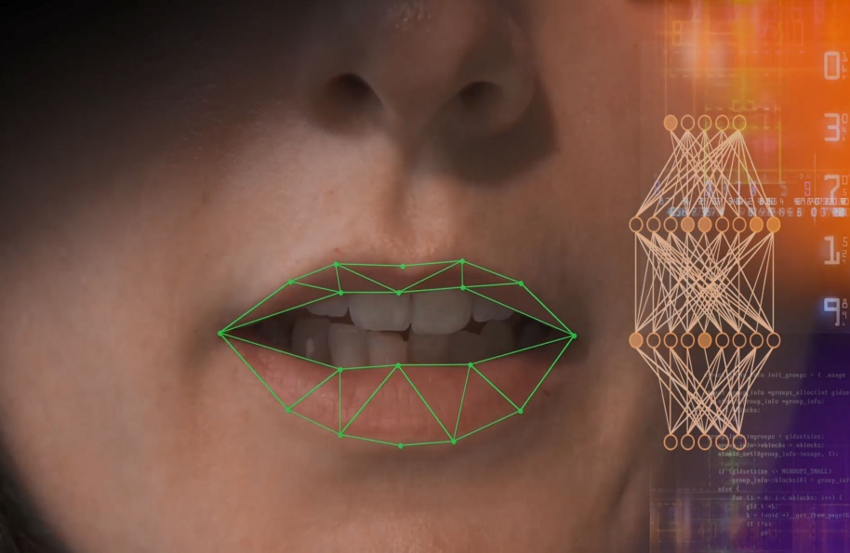

Slide 11
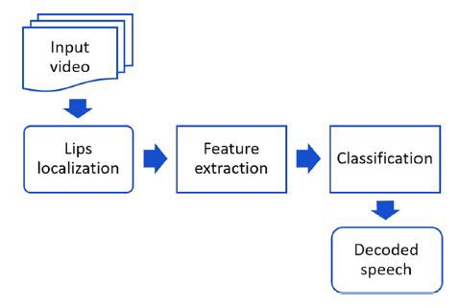
Process Flow

Slide 12
Tool’s
Tools | Tools | Version | Rationale
 | PyCharm | 2021.1.1 | Development
 | Tkinter | 2015 | GUI
 | Ms Word | 2015 | Documentation

Slide 13
Related System
Application Name | Weakness Proposed | Project Solution
Lip Reading in the Wild | Shortage of suitable datasets. | Automated large-scale data collection from TV broadcasts
Lipreading using Temporal Convolutional Networks | The current state-of-the-art methodology produces models that do not generalize well to variations on the sequence length | We address this issue by proposing a variable-length augmentation

Slide 14
Functional Requirements
Video Inserting
Video to Text

Slide 15
Non-Functional Requirements
language run time environment
Operating environment performance requirements
Usability requirements
Performance

Slide 16
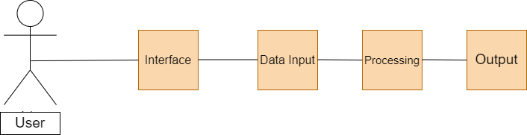
Architecture Diagram

Slide 17
Scope
People can communicate effectively in the noisy environment.
Who can interpret messages can use this efficiently.
Best to use as a search option in other apps.
Faulty people have a big go at it.
Will be good at video calls conference.

Slide 18
Future Work
Now this system can only predict through lips movement but in future this will be able to predict through sign languages to compensate the confusion that occurs through lips movement alone.
In future we will focus on adding more words in our vocabulary to help diversify speech.
Now the greater limitation in our system is that it can only predict lip movement in only single face pose but in future through heavy deal of pre-processing prediction can be possible in every face side

Slide 19
Conclusion
In conclusion, the problem facing people regarding hearing and speaking are numerous and with the current waves of public awareness, we utilize our research and learning in providing them a platform for reducing communication gaps. In beginning we start with 10 words and 100 sentences afterward we increase it and at the end there are almost 2 thousands words which user can utter by using our vocab and can get their results with higher Accuracy.

